Slide 1

Non-real-time simulated swing-up the double inverted pendulum with MPC
Miaoshun Wu
ESD 33289
1st Examiner:
Prof. Dr.-Ing. Kai Mueller
2nd Examiner:
Dr.-Ing. Jochen Schuettler
Tutor:
Dr.-Ing. Jochen Schuettler

Slide 2
Contents
Introduction
Set the TransWORHP
Run the Program in Visual Studio
Conclusion and Future Work
List of reference

Slide 3
Introduction
Double Inverted Pendulum (DIP)
Model Predictive Control (MPC)
TransWORHP( Optimizer )
The aim of this project

Slide 4
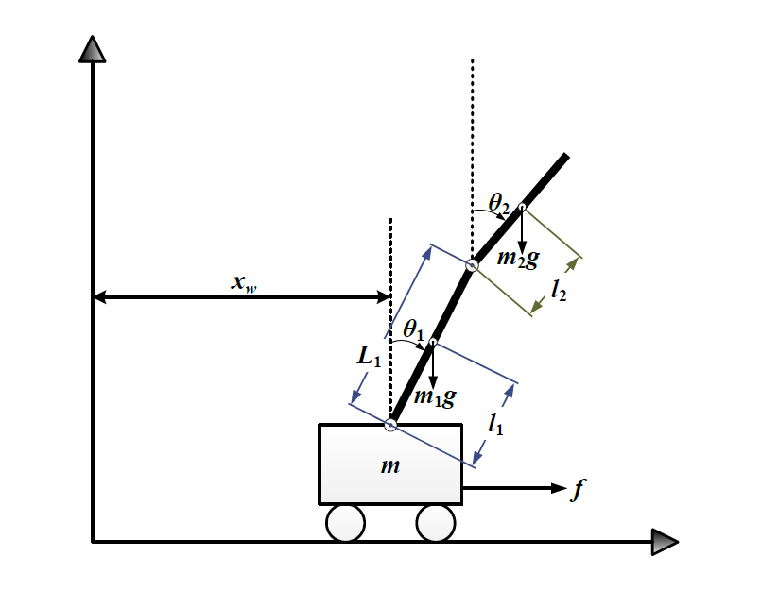
Double Inverted Pendulum (DIP)
Normally consists of two linked pendulums mounted on the cart.
This system is multi-variable, nonlinear, natural unstable system.
A typical physical model in control theory, often use this system to test the correctness of new control theory algorithms.

Slide 5
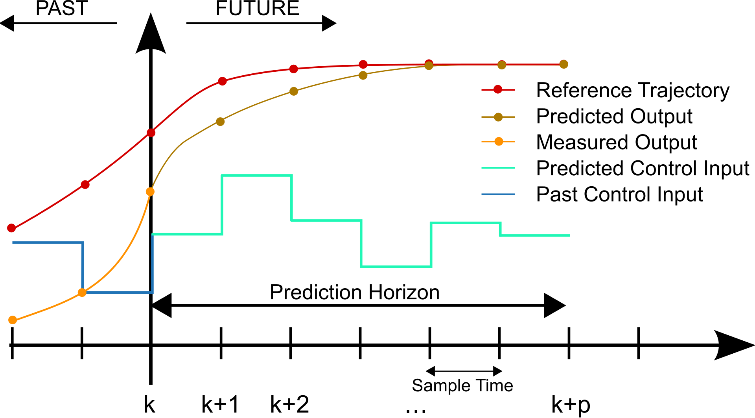
Model Predictive Control (MPC)
Used to control a process while satisfying a set of constraints.
Obtaining the optimal solution in a specific time domain at each sampling time. The current state of the process is the initial state of the optimal control problem.
Being widely used in aerospace, robot technology and general industrial process. For example, balancing control in robot walking, vertical control in rocket launching, etc.

Slide 6
TransWORHP(a highly efficient solver )
The numerical solution method developed by the AG Optimization and Optimal Control from Uni Bremen.
Based on the SQP method WORHP, the solution can be efficiently calculated using thin structures.
Designed to find locally optimal points of optimization problems and solve numeric problems.

Slide 7
The aim of this project
We manage to use model predictive control to swing up the double inverted pendulum with TransWORHP.

Slide 8
Contents
Introduction
Set the TransWORHP
Run the Program in Visual Studio
Conclusion and Future Work
List of reference

Slide 9
Set the TransWORHP
Objective function (obj function,obj-structure, obj-diff).
Dynamic system (ode system, ode-structure, ode-diff).
Boundary conditions & constraints

Slide 10
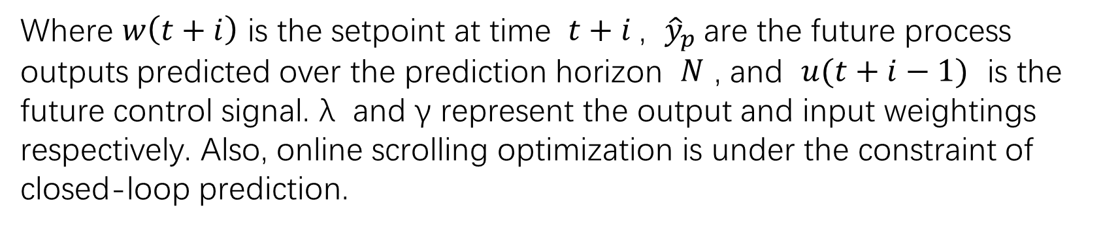
Objective function (obj-structure, obj-diff).
We can get the Objective function of NMPC according[2]
Where $w\left(t+i\right)$ is the setpoint at time $t+i$, ${\hat{y}}_{p}$are the future process outputs predicted over the prediction horizon $N$ , and $u(t+i−1)$ is the future control signal. λ and γ represent the output and input weightings respectively. Also, online scrolling optimization is under the constraint of closed-loop prediction.

Slide 11
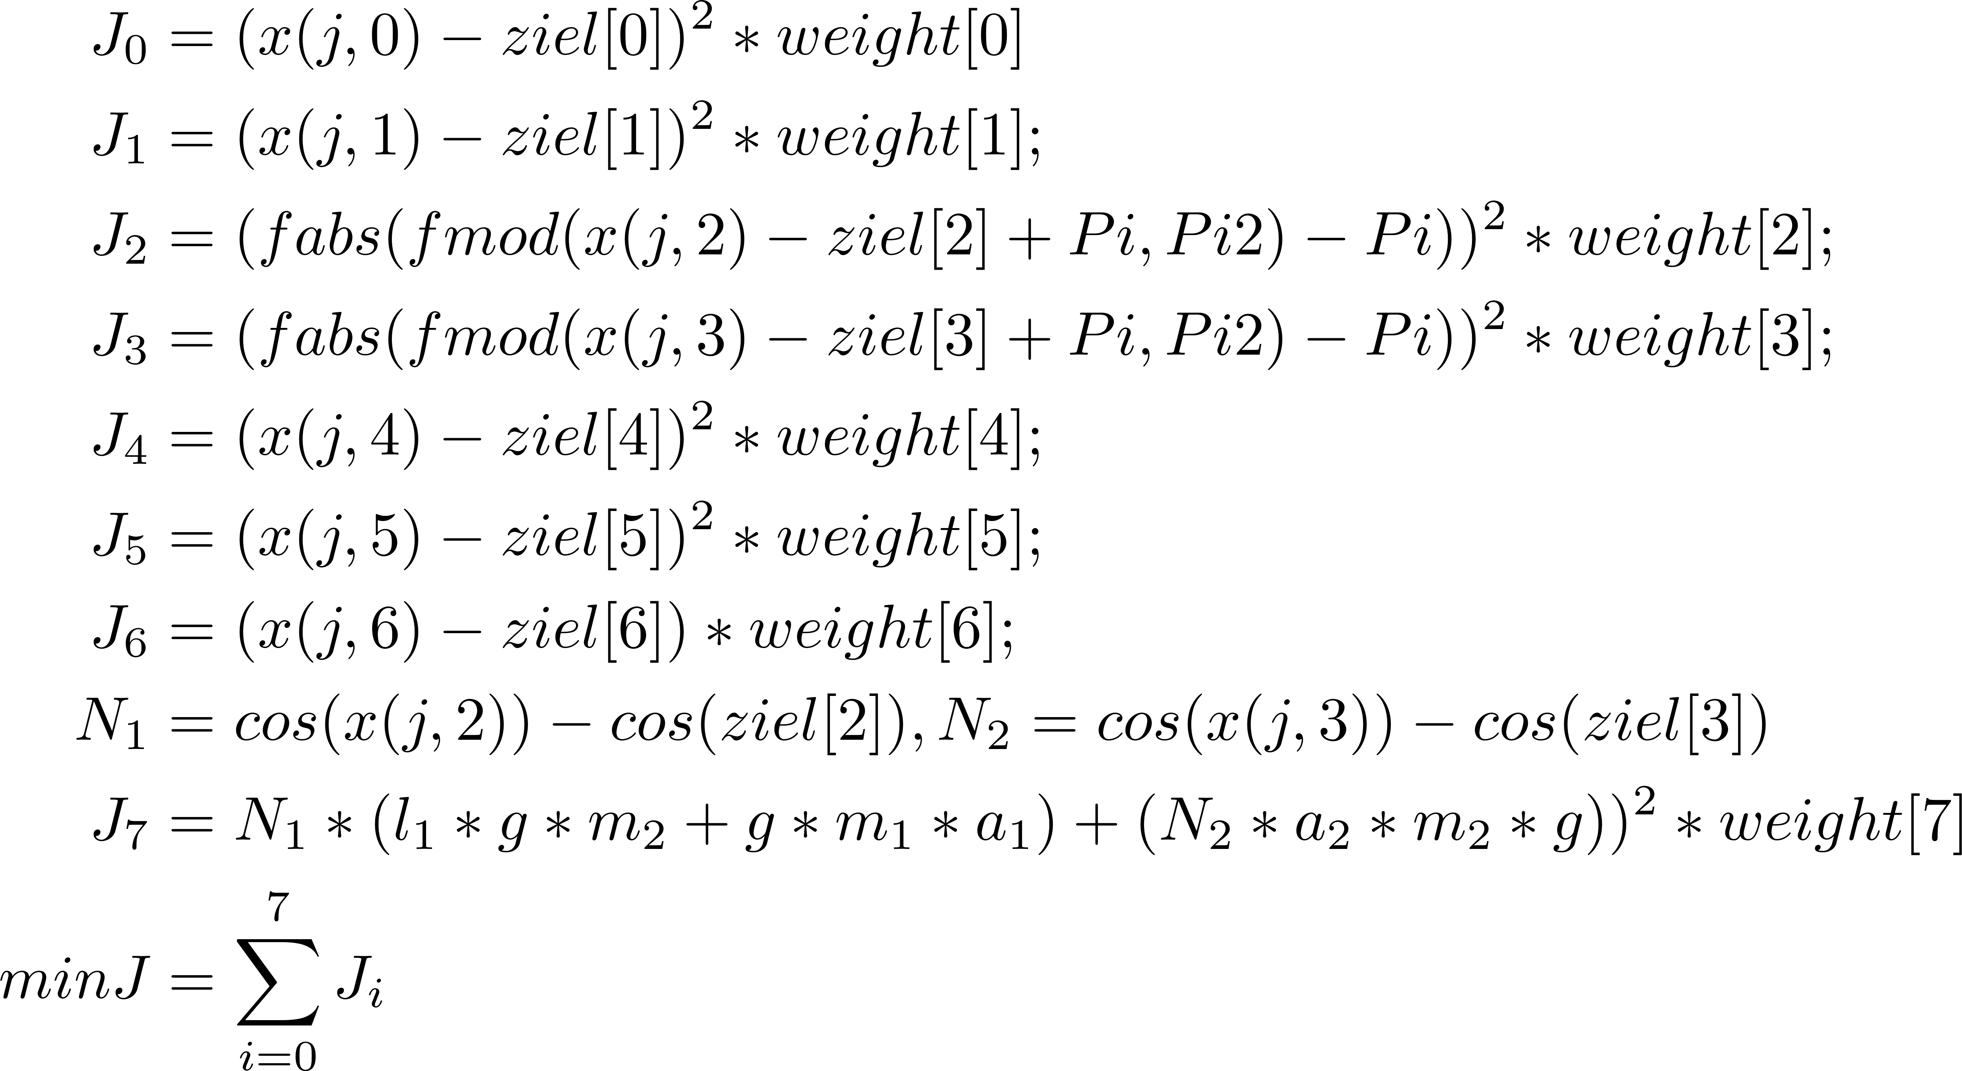
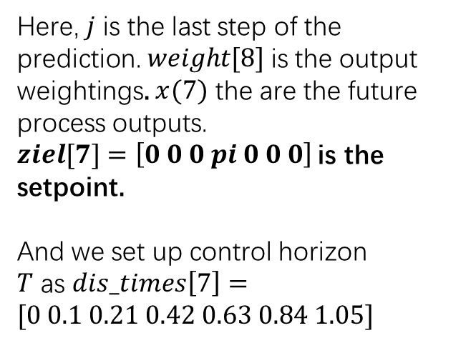
Objective function (obj-structure, obj-diff) in Visual Stduio
Here, $j$ is the last step of the prediction. $weight[8]$is the output weightings. $x(7)$ the are the future process outputs.
$ziel[7]$ $=\left[0 0 0 pi 0 0 0\right]$is the setpoint.
And we set up control horizon
$T$ as $dis_times\left[7\right]=[0 0.1 0.21 0.42 0.63 0.84 1.05]$

Slide 12
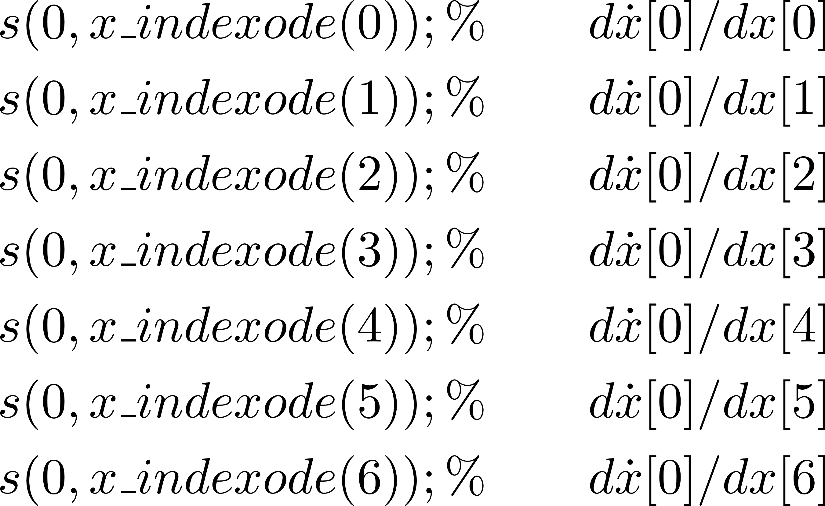
Derivative structures of Obj
According to the objective function, we can also get $obj_structure$ :

Slide 13
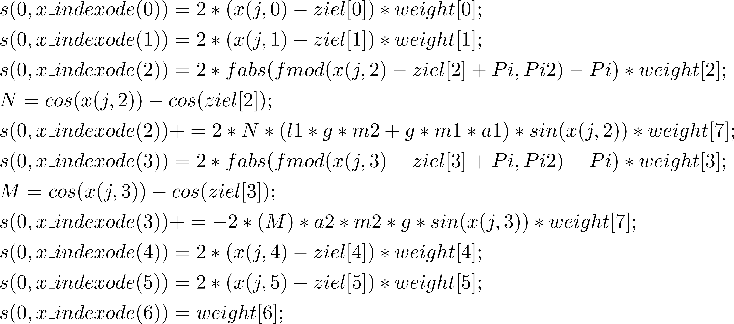
where $Obj_diff$:

Slide 14
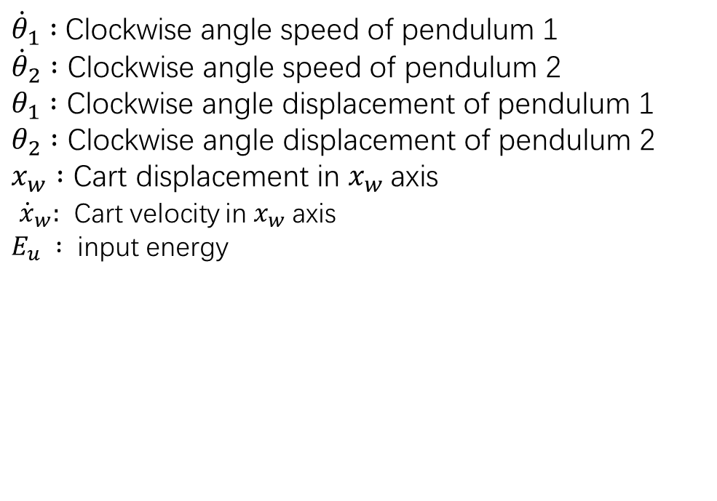
Dynamic system (ode-structure, ode-diff)
${\dot{θ}}_{1} :$Clockwise angle speed of pendulum 1
${\dot{θ}}_{2} :$ Clockwise angle speed of pendulum 2
$θ_{1} :$ Clockwise angle displacement of pendulum 1
$θ_{2} :$ Clockwise angle displacement of pendulum 2
$x_{w} :$ Cart displacement in $x_{w}$axis
${\dot{x}}_{w}:$ Cart velocity in $x_{w}$axis
$E_{u} :$ input energy

Slide 15
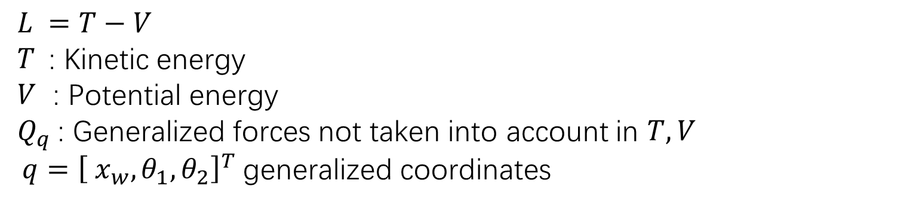
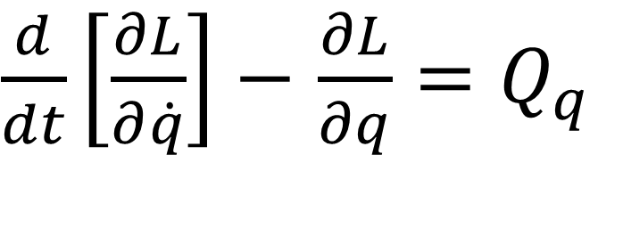
Euler-Lagrange equation
$\frac{d}{dt}\left[\frac{∂L}{∂\dot{q}}\right]−$ $\frac{∂L}{∂q}=Q_{q}$
$L =T−V$
$T$: Kinetic energy
$V$ : Potential energy
$Q_{q}$: Generalized forces not taken into account in $T, V$
$q={\left[ x_{w},θ_{1},θ_{2}\right]}^{T}$generalized coordinates

Slide 16
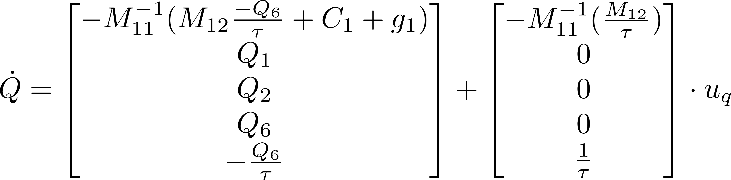
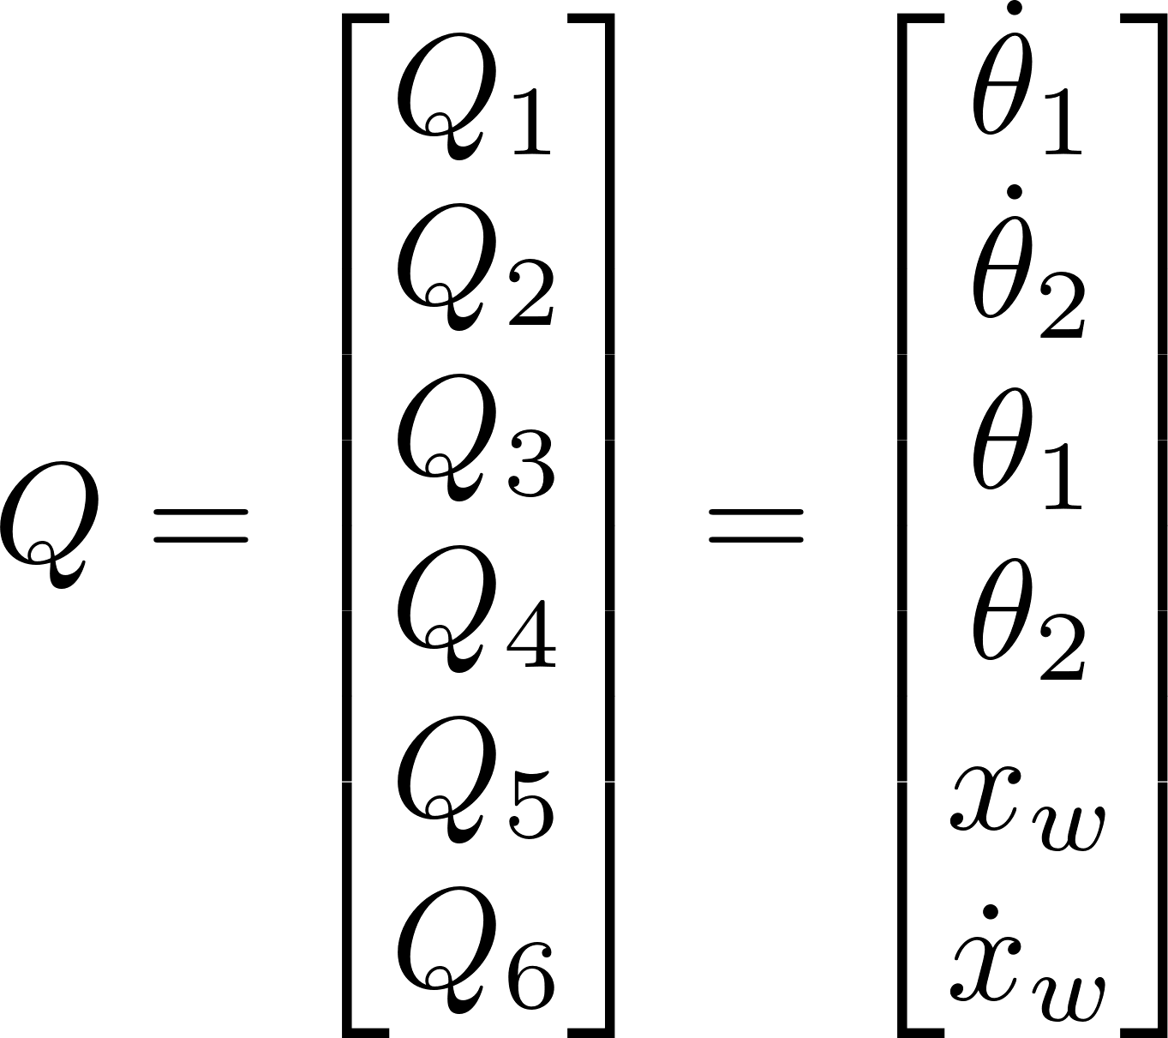
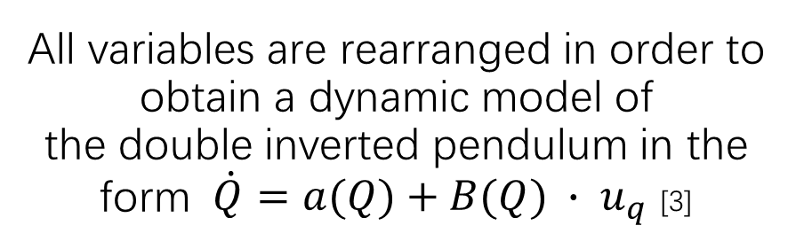
All variables are rearranged in order to obtain a dynamic model of the double inverted pendulum in the form $\dot{Q}=a(Q)+B(Q) ∙ u_{q}$ [3]
So the state space vector Q is defined as :

Slide 17
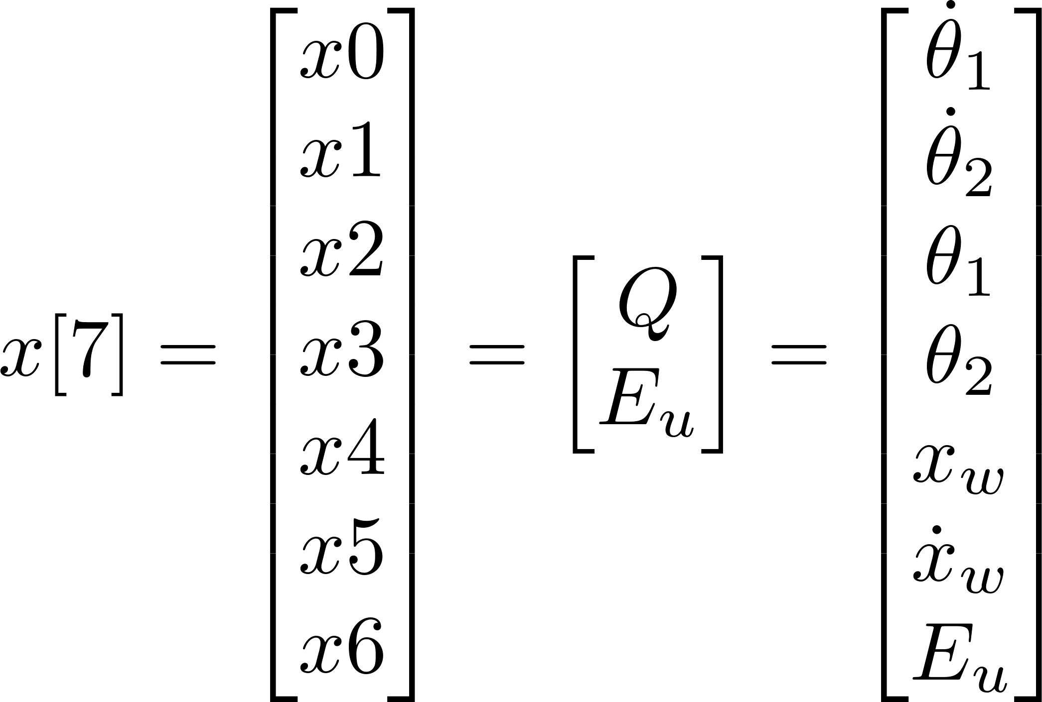
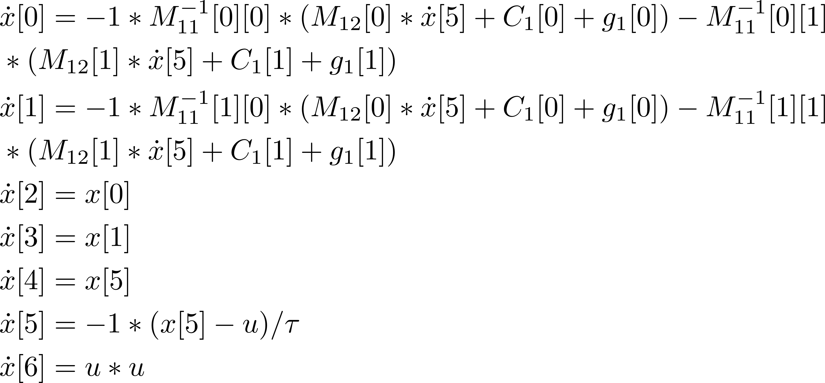
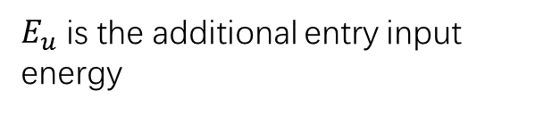
System State vector:
ODE system:
$E_{u}$ is the additional entry input energy

Slide 18
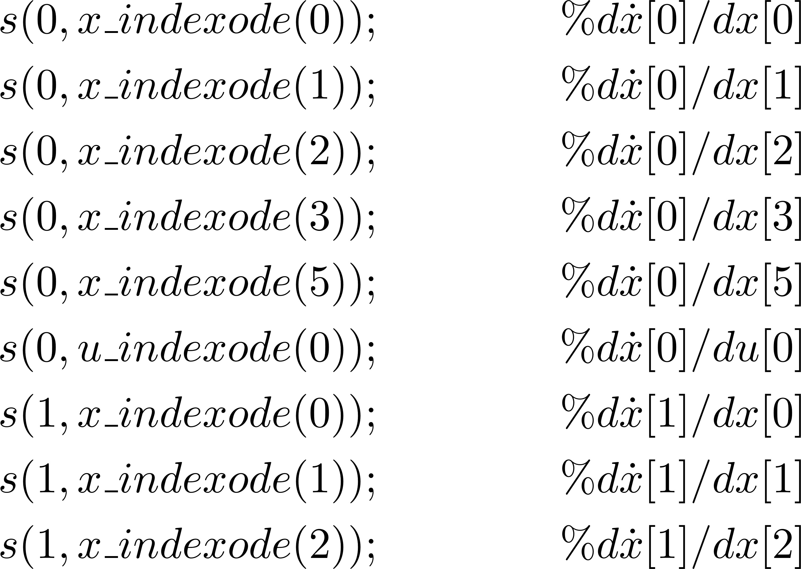
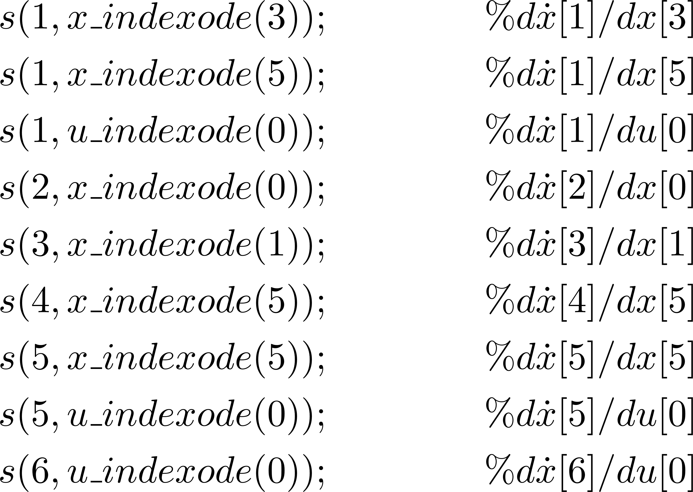
Derivative structures of ODE
In $ode_structure$ from TransWORHP , so we can get:

Slide 19
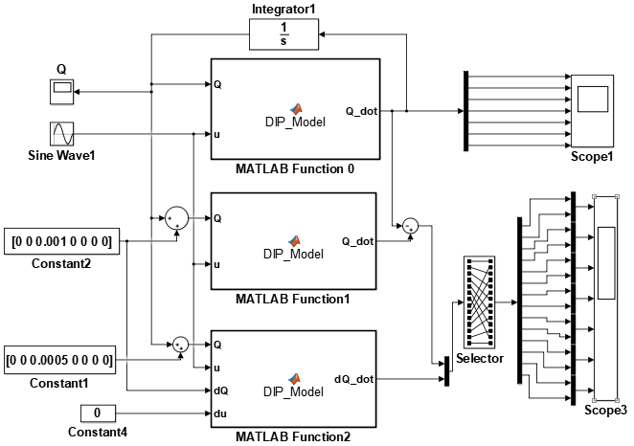
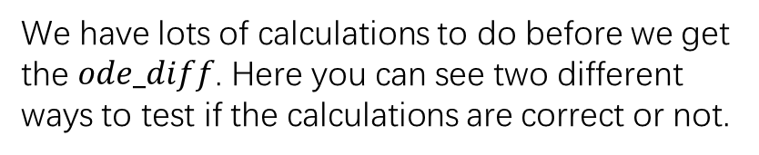

Check for $ode_diff$
We have lots of calculations to do before we get the $ode_diff$. Here you can see two different ways to test if the calculations are correct or not.
1. Matlab simulink function
2. TransWorhp viewer function

Slide 20
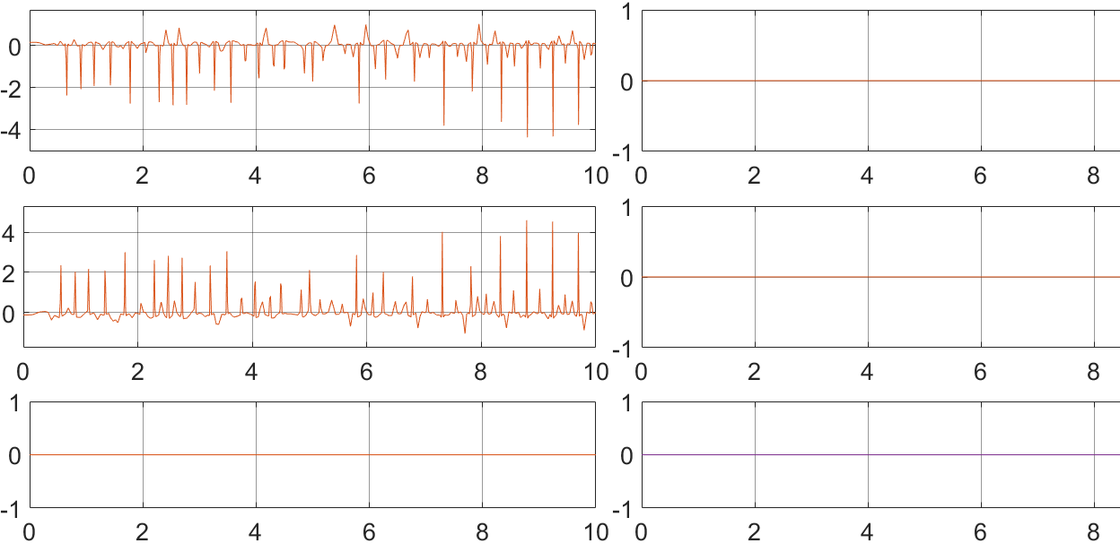

Check for $ode_diff$
1, Matlab simulink function

Slide 21
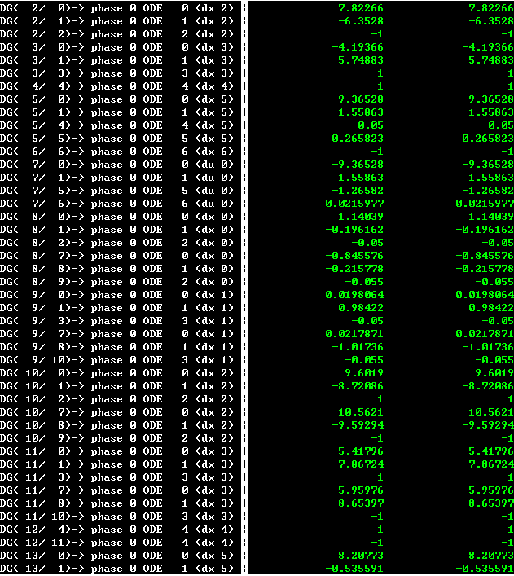

Check for $ode_diff$
2. TransWorhp viewer function

Slide 22
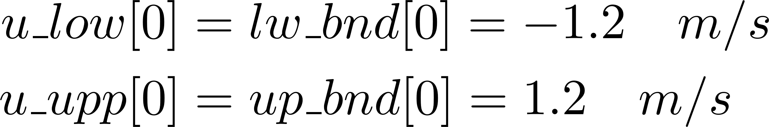
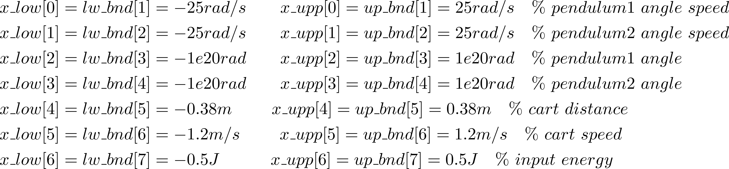
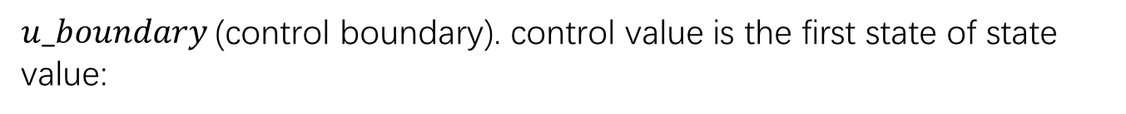
Boundary conditions & constraints
$u_boundary$(control boundary). control value is the first state of state value:
$x_boundary$(system boundary). System value is from second state value to 7th state value

Slide 23
Contents
Introduction
Set the TransWORHP
Run the Program in Visual Studio
Conclusion and Future Work
List of reference

Slide 24
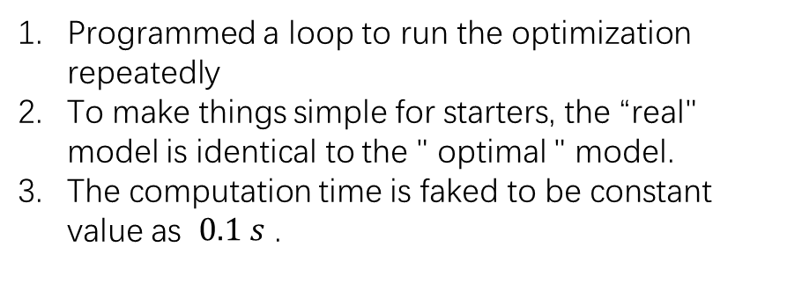
Run the Program in Visual Studio
Programmed a loop to run the optimization repeatedly
To make things simple for starters, the “real" model is identical to the " optimal " model.
The computation time is faked to be constant value as $0.1 s$ .
Inital input
Inital input
input
Optimal
Real
first output
Mesurement output
Setpoint

Slide 25
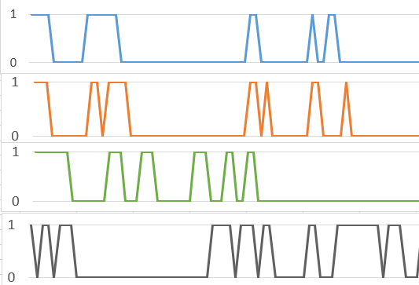
Optimal solution
During the running process of the program, the TransWORHP tries to find the optimal solution in each time step. I ran the same code for four times if finding the optimal solution is marked as 1, failing to find the optimal solution as 0, which can be seen from figure. Thus we can find out that the optimization often fails ,this may due to the old version of TransWORHP.

Slide 26
Output result
Although the TransWorhp can not find the optimal solution at each time step, we still can look at the ouput data
MPC.dat( detail data in each loop)
MPC2.dat( operation data)
MPC3.dat( optimization data + simulation data)
MPC4.dat( computation time after each loop ).
We can put the data file MPC3.dat( Shun1b.dat in Matlab) and MPC2.dat( Shun1.dat in Matlab) into Matlab visualization. Then we can get the figure

Slide 27
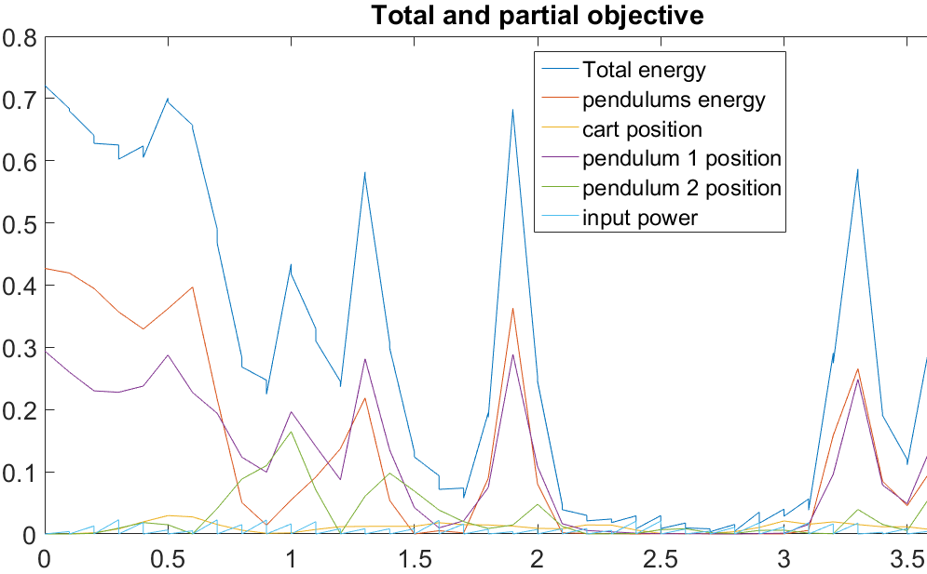
Decreasing to 0.

Slide 28
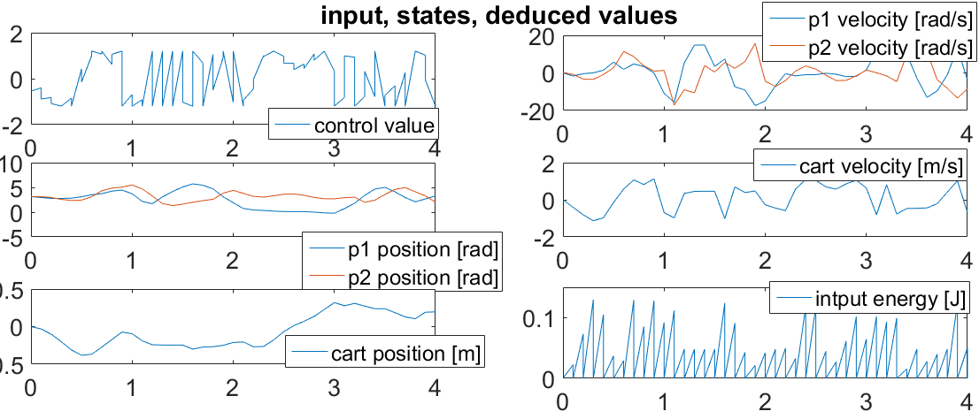

Slide 29
Introduction
Set the TransWORHP
Run the Program in Visual Studio
Conclusion and Future Work
List of reference

Slide 30
Conclusion
We did swing up the pendulum1 of double inverted pendulum by using model predictive control with TransWorhp in a short time.
Future work
set an additional balance controller
includes real-time issues
A new version of TransWORHP would be used
I hope that in the future work of this project, we can use MPC with our efficient solver to get the desired effect in solving non-linear process control.

Slide 31
List of reference
[1]. Spong, M. W.: ENERGY BASED CONTROL OF A CLASS OF UNDERACTUATED MECHANICAL SYSTEM. In: IFAC World Congress (1996), June
[2]. In: Chimmiri, V. : Model Predictive Control of Nonlinear Processes. 2010. ISBN 978-953-307-102-2
[3]. Nava, A. A.: Control Lyapunov Function based controller for a double inverted pendulum, University Bremen, master, 2015
[4]. Yue, Y. : Research on Nonlinear Predictive Control and Its Simulation,XIAN technology University, master, 2008
[5]. Schuettler, J. : Inverted pendulum. Bremen: Uni Bremen, Version 2.2.1,2013. Laboratory Script
[6].Zhong, W. ; Rock*, H. : Energy and Passivity Based Control of the Double Inverted Pendulum on a Cart. In: Control Systems Magazine, IEEE (2001), September, S. 896-901

Slide 32
Thank you!!

